Slide 1

PREDICTING HOUSE PRICE USING MACHINE LEARNING
PROJECT : HOUSE PRICE PREDICTION

Slide 2

Introduction:
Ask a home buyer to describe their dream house, and they probably won’t begin with the height of the basement ceiling or the proximity to an east-west railroad.
But this playground competition’s dataset proves that much more influences price negotiations than the number of bedrooms or a white-picket fence.
With 79 explanatory variables describing (almost) every aspect of residential homes in Ames, Iowa, this competition challenges you to predict the final price of each home.
Whether you’re a homeowner looking to estimate the value of your property,a real estate investor
Seeking profitable opportunities,or a data scientist aiming to built a predictive model,the foundation
Of this endeavor lies in loading and preprocessing the dataset.
Building a house price prediction model is a data-driven process that involves harnessing the power of machine learning to analize historical housing data and make informed price predictions.this journey begins with the fundamental steps of data loading and preprocessing.

Slide 3
Content for a Project Phase 2:
Consider exploring advanced regression techniques like Gradient Boosting or XGBoost for improved Prediction accuracy.
Data Source:
A good data source for house prediction using machine learning should be
Accurate,Complete,Covering the geographie area of interest,Accessible.
Data Link:(https://www.kaggle.com/datasets/vedavyasv/usa-housing)

Slide 4
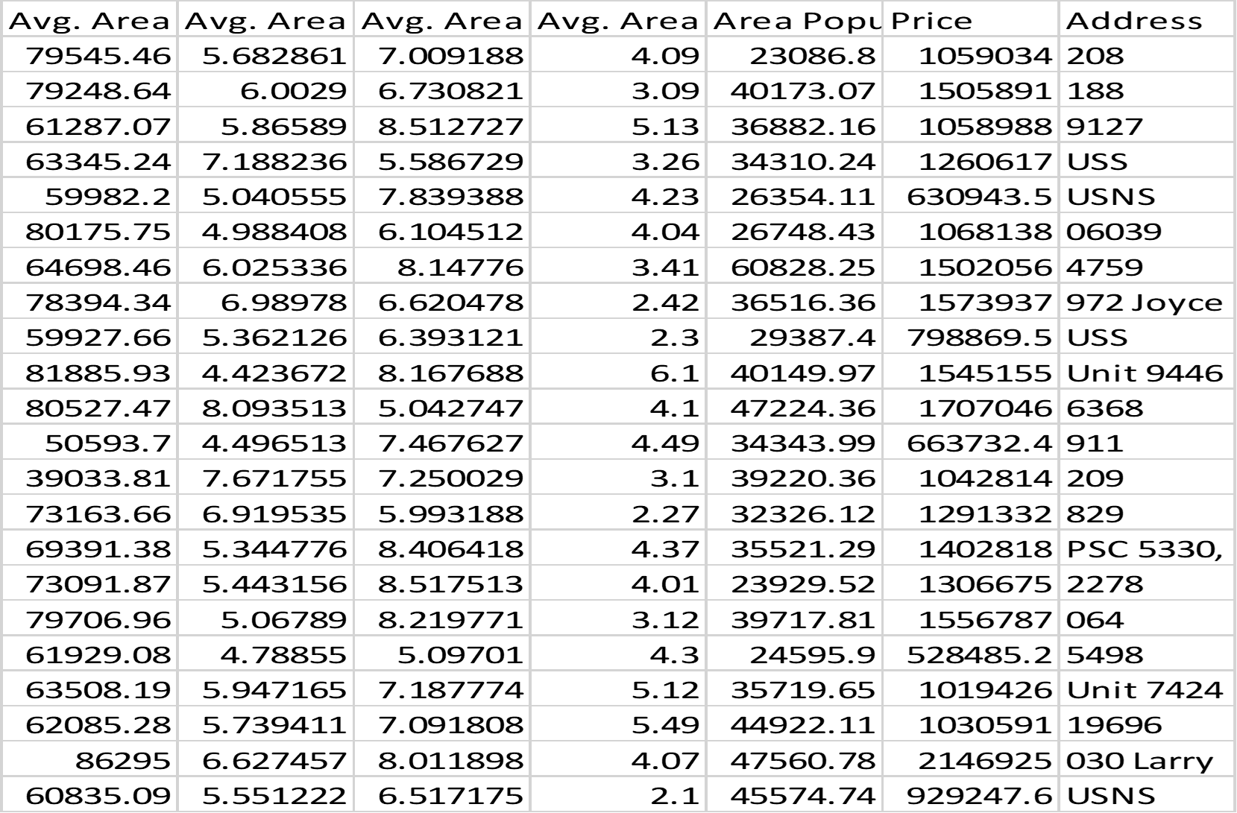

Slide 5
Advanced Regression Techniques:
Ridge Regression:Introduce L2 regularization to mitigate multicollinearity and overfitting.
Lasso Regression:Employ L1 regularization to perform selection and simplify the model
ElasticNet regression:combine both L1and L2 regularization to benefit from their respective advantages.
Random forest regression:implement an ensemble technique to handle non-linearity and capture complex relationship in the data
Gradient boosting regressors(eg.XGBoost,LightGBM):
Utilize gradient boosting algorithms for improved accuracy.

Slide 6
Program:
import pandas as pd
import numpy as np
import seaborn as sns
import matplotlib.pyplot as plt
from sklearn.model_selection import train_test_split
from sklearn.preprocessing import StandardScaler
from sklearn.metrics import r2_score, mean_absolute_error,mean_squared_error
from sklearn.linear_model import LinearRegression
from sklearn.linear_model import Lasso
from sklearn.ensemble import RandomForestRegressor
from sklearn.svm import SVR
import xgboost as xg
%matplotlib inline
import warnings
warnings.filterwarnings("ignore")
opt/conda/lib/python3.10/site-packages/scipy/__init__.py:146: UserWarning: A NumPy version >=1.16.5 and <1.23.0 is required for this version of SciPy (detected version 1.23.5 warnings.warn(f"A NumPy version >={np_minversion} and <{np_maxversion}"
Loading Dataset
In [2]:

Slide 7
dataset = pd.read_csv('/kaggle/input/usa-housing/USA_Housing.csv')
Model 1 - Linear Regression
IN[1]:
model_lr=LinearRegression()
IN[2]:
model_lr.fit(X_train_scal, Y_train)
OUT[2]:
LinearRegression
LinearRegression()
Predicting Prices
Prediction1 = model_lr.predict(X_test_scal)
Evaluation of Predicted Data
plt.figure(figsize=(12,6))
plt.plot(np.arange(Y_test)), Y_test, label='Actual Trend')
plt.plot(np.arange(Y_test)), Prediction1, label='Predicted Trend')
plt.xlabel('Data')

Slide 8
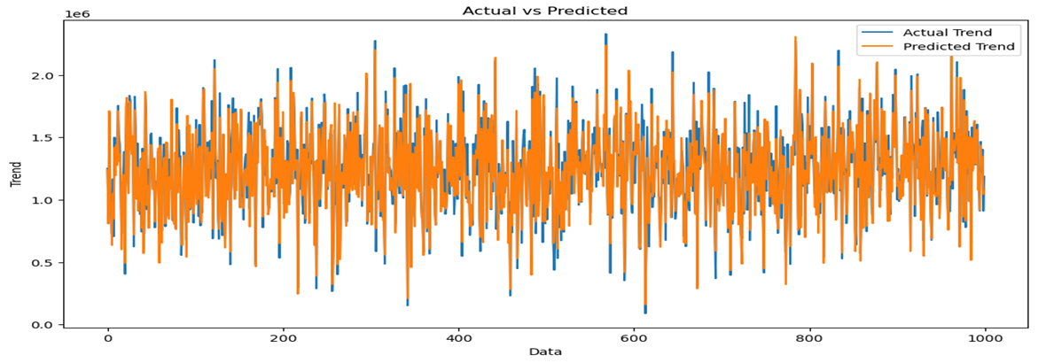
Output:
Text(0.5, 1.0, 'Actual vs Predicted')
IN[5]:
sns.histplot((Y_test-Prediction1), bins=50)
OUT[5]:
<Axes: xlabel='Price', ylabel='Count'>

Slide 9
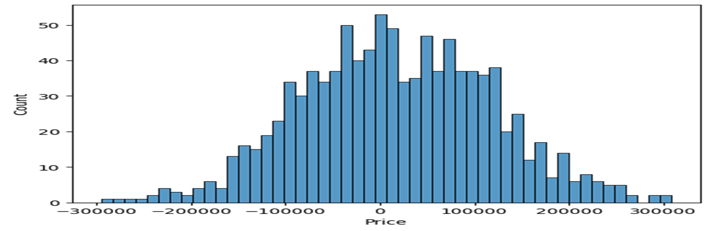
IN[6]
print(r2_score(Y_test, Prediction1))
print(mean_absolute_error(Y_test, Prediction1))
print(mean_squared_error(Y_test, Prediction1))
OUT[6]:
0.9182928179392918
82295.49779231755
10469084772.975954

Slide 10
Model 2 - Support Vector Regressor
IN[7]:
model_svr = SVR()
IN[8]:
model_svr.fit(X_train_scal, Y_train)
OUT[8]:
SVR
SVR()
Predicting Prices
IN[9]:
Prediction2 = model_svr.predict(X_test_scal)
Evaluation of Predicted Data
IN[10]:
plt.figure(figsize=(12,6))
plt.plot(np.arange(len(Y_test)),Y_test,label='ActualTrend')

Slide 11
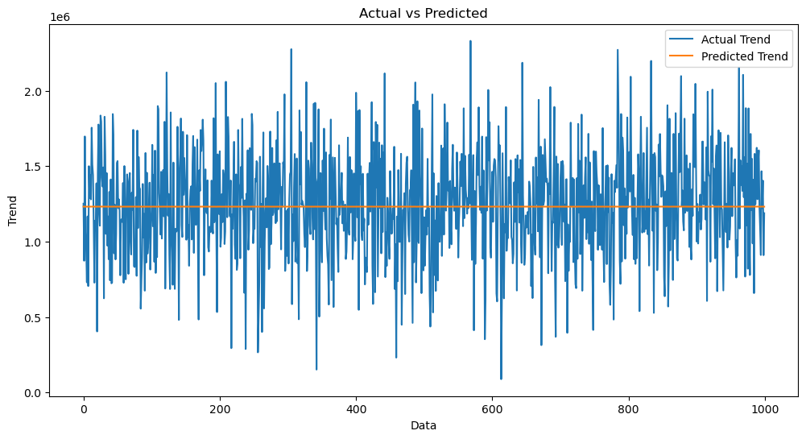
plt.plot(np.arange(Y_test)), Prediction2, label='Predicted Trend')
plt.xlabel('Data')
plt.ylabel('Trend')
plt.legend()
plt.title('Actual vs Predicted')
OUT[10]:
Text(0.5, 1.0, 'Actual vs Predicted')

Slide 12
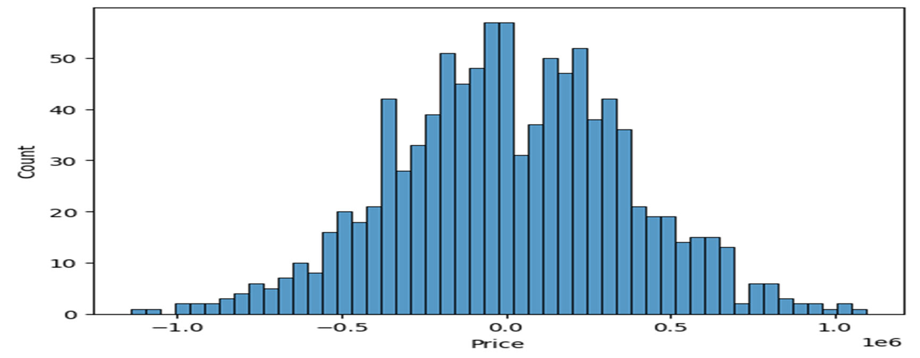
IN[11]:
sns.histplot((Y_test-Prediction2), bins=50)
OUT[12]:
<Axes: xlabel='Price', ylabel='Count'>

Slide 13
IN[12]:
print(r2_score(Y_test, Prediction2))
print(mean_absolute_error(Y_test, Prediction2))
print(mean_squared_error(Y_test, Prediction2))
--0.0006222175925689744
286137.81086908665
128209033251.4034
Model 3 - Lasso Regression
IN[13]
model_lar = Lasso(alpha=1)
IN[14]
model_lar.fit(X_train_scal,Y_train)
OUT[14]
Lasso
Lasso(alpha=1)
Predicting Prices
Prediction3 = model_lar.predict(X_test_scal)

Slide 14

Evaluation of Predicted Data
IN[16]:
plt.figure(figsize=(12,6))
plt.plot(np.arange(Y_test)), Y_test, label='Actual Trend')
plt.plot(np.arange((Y_test)), Prediction3, label='Predicted Trend')
plt.xlabel('Data')
plt.ylabel('Trend')
plt.legend()
plt.title('Actual vs Predicted')
OUT[16]:
Text(0.5, 1.0, 'Actual vs Predicted')

Slide 15

IN[17]: sns.histplot((Y_test-Prediction3), bins=50)
OUT[17]:
sns.histplot((Y_test-Prediction3), bins=50)
In[18]:
print(r2_score(Y_test, Prediction2))
print(mean_absolute_error(Y_test, Prediction2))
print(mean_squared_error(Y_test, Prediction2))
-0.0006222175925689744
286137.81086908665
128209033251.4034

Slide 16
Necessary Steps to Follow:
1)Import Necessary Libraries
Start by importing the necessary libraries
import pandas as pd
import numpy as np
from sklearn.model_selection import train_test_split
from sklearn.preprocessing import StandardScaler
2)Load the Dataset
Load your dataset into a Pandas DataFrame.You can typically find house price datasets in CSV format,but you can adapt this code to other formats as needed.
Program:
df=pd.read_csv(‘E:\USA_Housing.csv’)
pd.read()
3)Exploratory Data Analysis(EDA):
Perform EDA to understand your data better.This includes checking for missing values,exploring the data’s statistics,and visualizing it to identify patterns.
Program:
#Check for missing values
Print(df.isnull().sum())

Slide 17
#Explore statistics
Print(df.describe())
#Visualize the data(e.g.,histograms,scatter plots,etc.)
4)Feature Engineering:
Depending on your dataset,you may need to crate new features or transform existing ones.This can involve one-hot encoding categorical variables,handling date/time data,or scaling numerical features.
Program:
#Example:One-hot encoding for categorical variables
df=pd.get_dummies(df,columns=[‘Avg.Area Income’,’Avg.Area Housing Age;])
5)Split the Data:
Split your dataset into training and testing sets.This helps you evaluate your model’s performance later.
X = df.drop(‘price', axis=1) # Features
y = df[‘price'] # Target variable
X_train, X_test, y_train, y_test = train_test_split(X, y, test_size=0.2, random_state=42)

Slide 18
6)Feature Scaling:
Apply feature scaling to normalize your data,ensuring that all features have similar scales.Standardization(scaling to mean=0 and std=1)is a common choice.
Program:
scaler=StandardScaler()
X_train=scaler.fit_transform(X_train)
X_test=scaler.transform(X_test)
Importance of loading and processing dataset:
Loading and preprocessing the dataset is an important first step in building any machine learning model.However,it is especially impotant for housing price prediction models,as house price datasetsare often complex and noisy.
By loading and preprocessing the dataset,we can ensure that the machine learning algorithm is able to learn from the data effectively and accurately.
Challenges involved in loading and preprocessing a house price dataset:
There are a number of challenges involved in loading and preprocessing a house price dataset,including:
Handling missing values:
House price datasets often contain missing values,which can be due to a variety of factors.such as human error or incomplete data collecton.Common methods for handling missing values include dropping the rows with missing values,imputing the missing

Slide 19
Values,imputing the missing values with the mean or median of the feature,or using a sophisticated method such as multiple imputing.
Encoding categorical variables:
Housing price datasets often contain categorical features,such as the type of housing,the neighborhood,and the school district.These features need to be encoded before theycan be used by machine learning models.One common way to encode categorical variables is to use One-hot encoding.
Scaling the features:
It is often helpful to scale the features before training a machine learning model.This ca help to improve the performance of the model and make it more robust to outliers.There are a variety of ways to scale the features,such as mim-max scaling and standard scaling. Splitting the dataset into training and testing sets:
Once the data has been pre-processed,we need to split the dataset into training and testing sets.The training set will be used to evaluate the the performance of the model on unseen data.It is important to split the dataset in a way that is representative of the real world distribution of the data
How to overcome the challenges of loading and preprocessing a house price dataset:
There are a number of things that can be done to overcome the challenges of loading and preprocessing a house price dataset.includind

Slide 20

Use a data preprocessing library:
There are a number of libraries available that can help with data preprocessing tasks,such as handling missing values,encoding categorical variables,and scaling the features.
Carefully consider the specific needs of your model:
The best way to preprocess the data will depend on the specific machine learning algorithm that you are using.It is important to carefully consider the requirements of the algorithm and to preprocess the data in a way that is compatible with the algorithm.
Validate the preprocessed data:
It is important to validate the preprocessed data to ensure that it is in a format that can be used by the machine learning algorithm and tht it is of high quality.This can be done by inspecting the data visually or by using statistical methods.
1.Loading the dataset:
Loading the dataset using machine learing is the process of bringing the data into the machine learning environment so that it can be used to train anf evaluate a model
The specific steps involved in loading the dataset will vary depending on the machine learning library or framework that is being used. However,that are some general steps that
Are common to most machine learning framework:

Slide 21


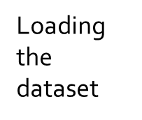
a)Identify the dataset:
The first step is to identify the dataset that you want to load.This dataset may be stored in a local file, in a database,or in a cloud storage service.
b)Load the dataset:
Once you have identified the dataset,you need to lead it into the machine learning environment.This may involve using a built-in function in the machine learning library,or it may involve writing your own code.
c)Preprocess the dataset:
Once the dataset is loaded into the machine learning environment,you may need to preprocess it before you can start training and evaluating your model.This may involve cleaning the data,transforming the data into a suitable format, and splitting the data into training and test sets.
Identify the dataset
Preprocessing the
dataset
Loading the dataset

Slide 22
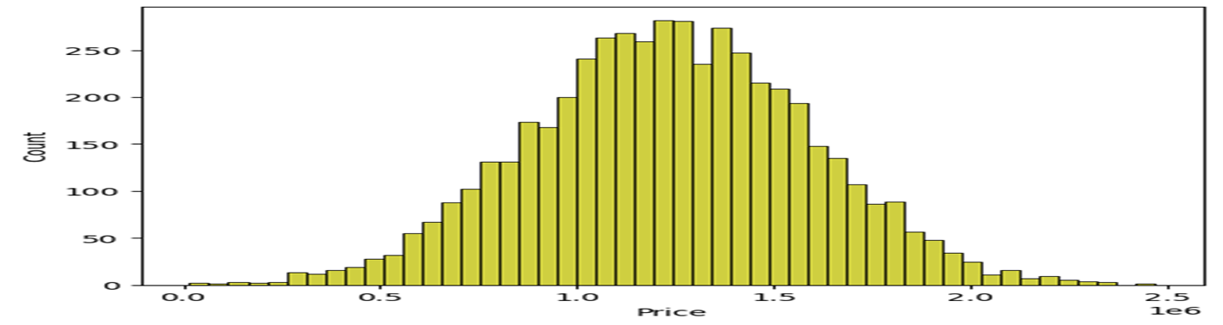
Preprocessing the dataset:
Data preprocessing is the process of cleaning,transforming,and integrating data in order to make it ready for analysis.
This may involve removing errors and inconsistencies,handling missing values,transforming the data into a consistent format,and scaling the data to a suitable range.
Visualisation and Pre-Processing of Data
IN[1]:
sns.histplot(dataset, x='Price', bins=50, color='y')
OUT[1]:
<Axes: xlabel='Price', ylabel='Count'>

Slide 23
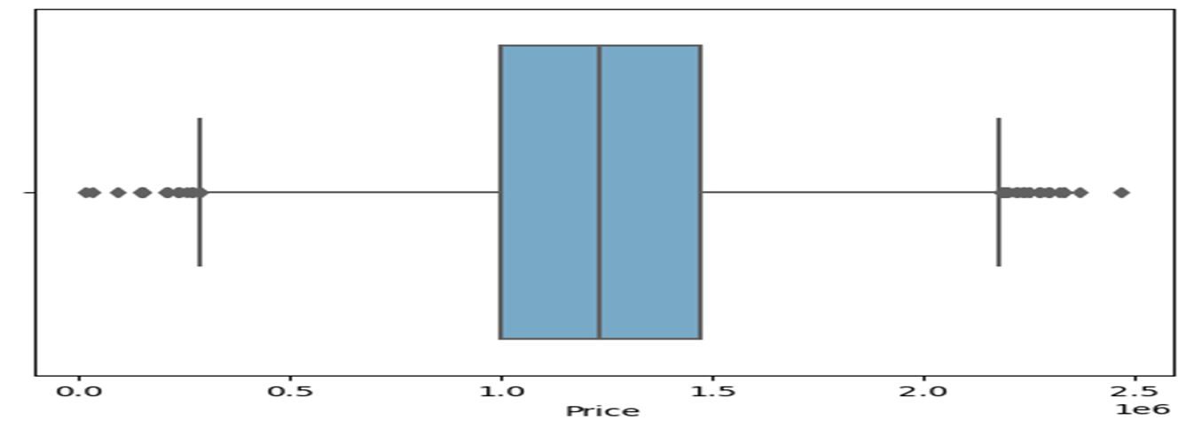

IN[2]:
sns.boxplot(dataset, x='Price', palette='Blues')
OUT[2]:
<Axes: xlabel='Price'>
sns.jointplot(dataset, x='Avg. Area House Age', y='Price', kind='hex')
OUT[3]:
<seaborn.axisgrid.JointGrid at 0x7dbe246100a0>

Slide 24
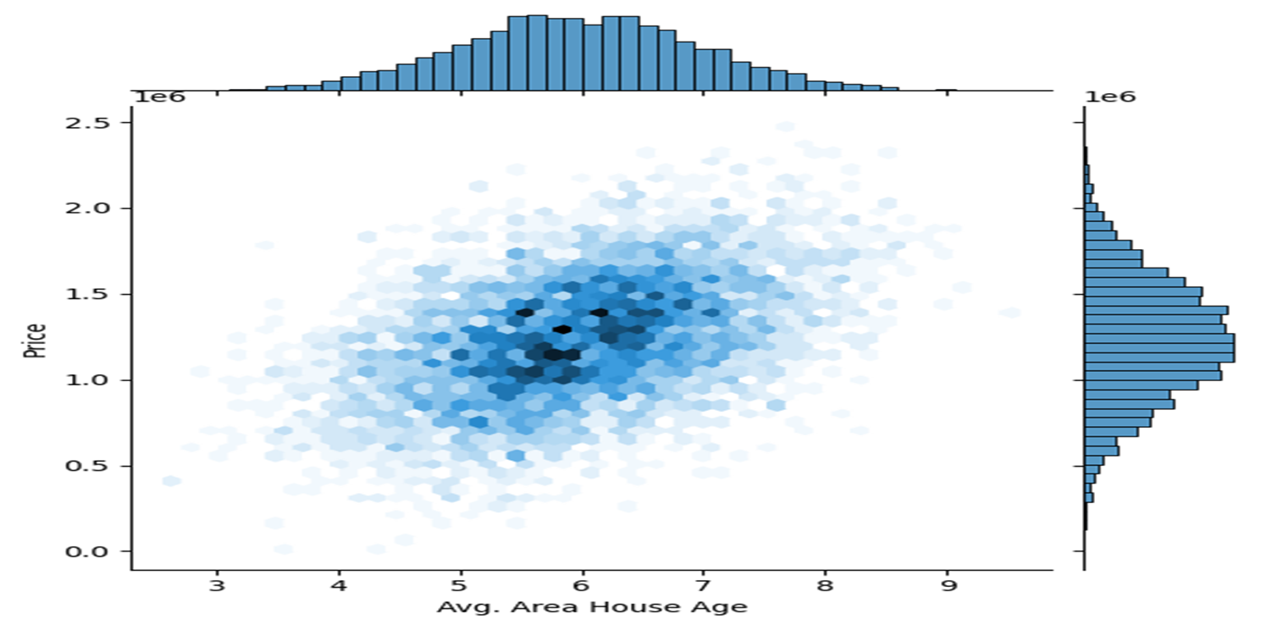
IN[4]:
sns.jointplot(dataset, x='Avg. Area Income', y='Price')
OUT[4]:
<seaborn.axisgrid.JointGrid at 0x7dbe1333c250>

Slide 25
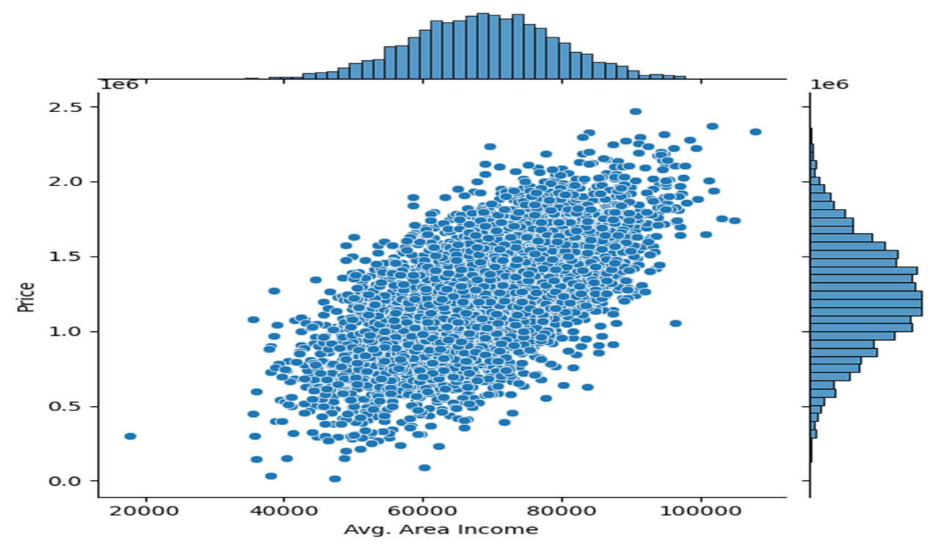
IN[5]:
plt.figure(figsize=(12,8))
sns.pairplot(dataset)
OUT[5]:
<seaborn.axisgrid.PairGrid at 0x7dbe1333c340>

Slide 26
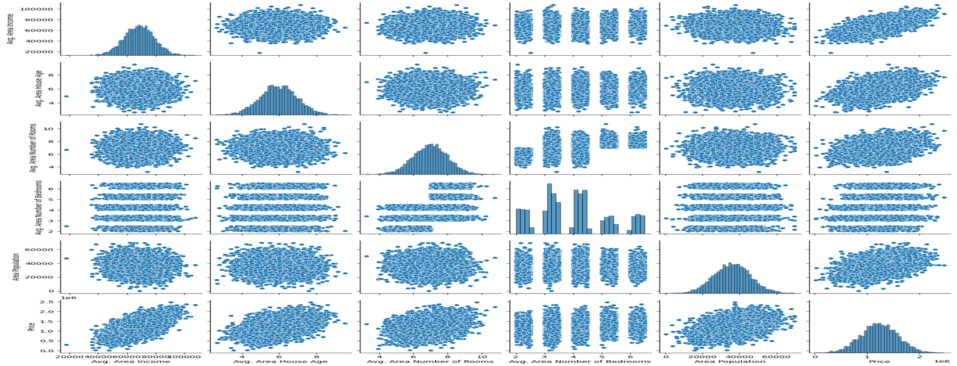
IN[6]:
dataset.hist(figsize=(10,8))
OUT[6]:
array([[<Axes: title={'center': 'Avg. Area Income'}>,
<Axes: title={'center': 'Avg. Area House Age'}>],
[<Axes: title={'center': 'Avg. Area Number of Rooms'}>,
<Axes: title={'center': 'Avg. Area Number of Bedrooms'}>],
[<Axes: title={'center': 'Area Population'}>,
<Axes: title={'center': 'Price'}>]], dtype=object)

Slide 27
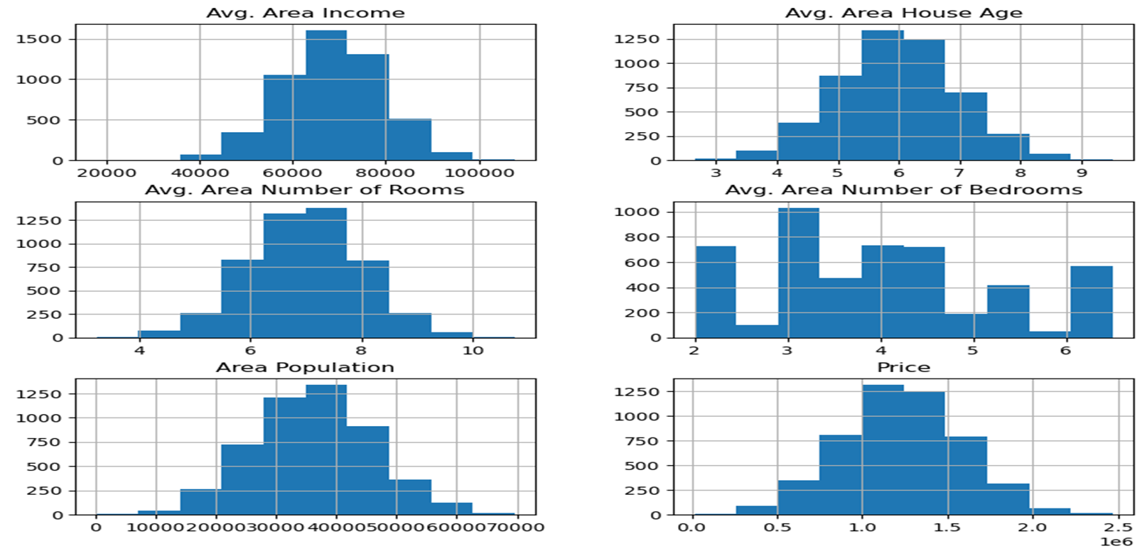
Visualising Correlation
IN[7]:
dataset.corr(numeric_only=True)

Slide 28
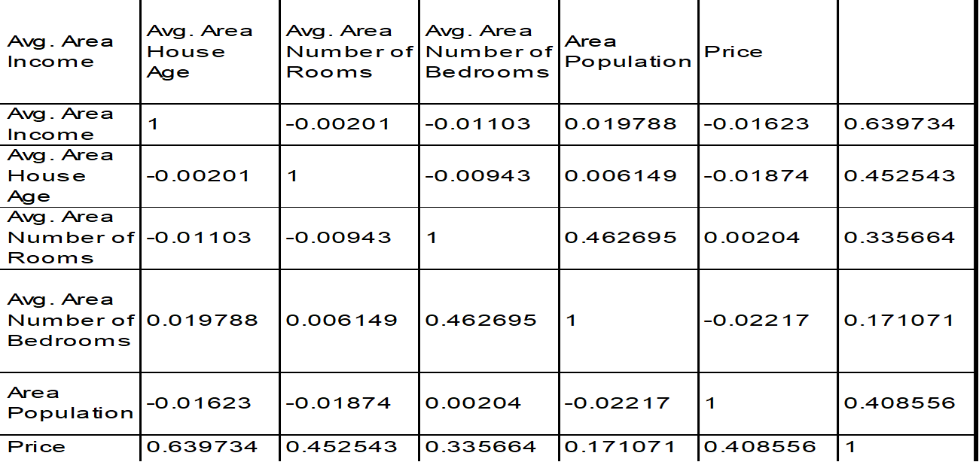
OUT[7]:
IN[8]:
plt.figure(figsize=(10,5))
sns.heatmap(dataset.corr(numeric_only = True), annot=True)
OUT[8]:
<Axes: >

Slide 29
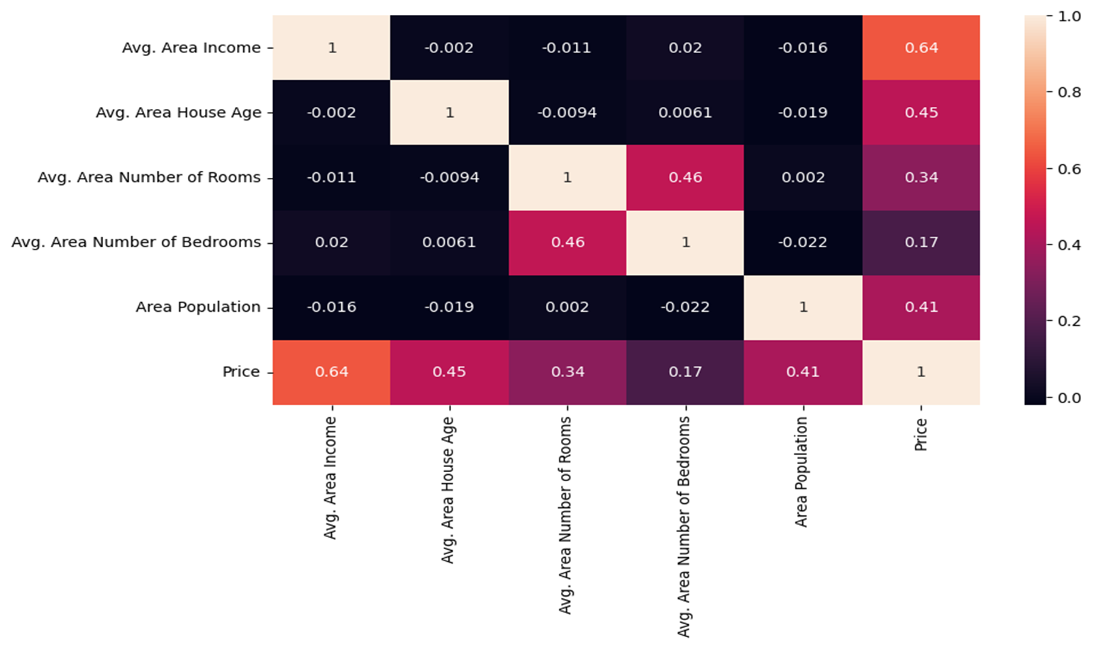

Slide 30
Overview of the process:
The following is an overview of the process of building a house price prediction model
by feature selection,model training and evaluation.
1.Prepare the Data: This includes cleaning the Data,removing outliers,and handling missing values.
2.Perform feature selection: This can be done using a variety of methods,such as correlation analysis,information gain,and recursive feature elimination.
3.Train the model: There are many different machine learning algorithm that can be used for house price prediction some popular choices include linear regression,random forests,and gradient boosting machines.
4.Evaluate the model: This can be done by calculating the mean squared error(MSE)or the root mean squared error(RMSE)of the model’s prediction on the held-out test set.
5.Deploy the model: Once the model has been evaluated and found to be performing well,it can bedeployed to production so that it can be used to predict the house prices of new houses

Slide 31
PROCEDURE:
Feature selection:
Identify the target variable: This is the variable that you want to predict,such as house price.
2.Explore the Data: This will help you to understand the relationships between the different features and the target variable .You can use data visualization and correlation analysis to identify features that are highly correlated with the target variable.
3.Remove redundant features: If two features are highly correlated with each other ,then you can remove one of the features as they are used to predict the house price of new houses.

Slide 32
Model training:
Training a house price prediction model involves the process of fitting a machine learning algorithm to a dataset containing features related to houses (e.g., number of bedrooms, square footage, location, etc.) and their corresponding prices.
Model= LinearRegression()
# Import necessary libraries
import numpy as np
import matplotlib.pyplot as plt
from sklearn.linear_model import LinearRegression
from sklearn.model_selection import train_test_split
from sklearn.metrics import mean_squared_error
# Generate some example data
np.random.seed(0)
X = np.random.rand(100, 1) # Independent variable
y = 2 * X.squeeze() + np.random.randn(100) # Dependent variable with some random noise

Slide 33
# Initialize the Linear Regression model
model = LinearRegression()
# Train the model
model.fit(X_train, y_train)
# Predict using the test set
y_pred = model.predict(X_test)
# Calculate Mean Squared Error (MSE)
mse = mean_squared_error(y_test, y_pred)
print(f"Mean Squared Error (MSE): {mse}")
# Visualize the results
plt.scatter(X_test, y_test, color='blue', label='Actual')
plt.plot(X_test, y_pred, color='red', label='Predicted')
plt.xlabel('X')
plt.ylabel('y')
plt.legend()
plt.show()

Slide 34
# Import necessary libraries
from sklearn.linear_model import Ridge
from sklearn.model_selection import train_test_split
from sklearn.metrics import mean_squared_error
import numpy as np
# Assuming you have X (features) and y (target variable) ready
# Split data into training and testing sets
X_train, X_test, y_train, y_test = train_test_split(X, y, test_size=0.2, random_state=42)
# Initialize the Ridge regression model with alpha value
alpha = 1.0 # You can adjust this hyperparameter
ridge_model = Ridge(alpha=alpha)
# Train the model
ridge_model.fit(X_train, y_train)
# Predict house prices on the test set
y_pred = ridge_model.predict(X_test)
# Evaluate the model using Mean Squared Error (MSE)
mse = mean_squared_error(y_test, y_pred)
print(f"Mean Squared Error (MSE): {mse}")
Redge
Regression:

Slide 35
# Import necessary libraries
from sklearn.linear_model import Lasso
from sklearn.model_selection import train_test_split
from sklearn.metrics import mean_squared_error
import numpy as np
# Assuming you have X (features) and y (target variable) ready
# Split data into training and testing sets
X_train, X_test, y_train, y_test = train_test_split(X, y, test_size=0.2, random_state=42)
# Initialize the Lasso regression model with alpha value
alpha = 1.0 # You can adjust this hyperparameter
lasso_model = Lasso(alpha=alpha)
# Train the model
lasso_model.fit(X_train, y_train)
# Predict house prices on the test set
y_pred = lasso_model.predict(X_test)
# Evaluate the model using Mean Squared Error (MSE)
mse = mean_squared_error(y_test, y_pred)
print(f"Mean Squared Error (MSE): {mse}")
Lasso
Regression:

Slide 36
# Import necessary libraries
from sklearn.linear_model import ElasticNet
from sklearn.model_selection import train_test_split
from sklearn.metrics import mean_squared_error
import numpy as np
# Assuming you have X (features) and y (target variable) ready
# Split data into training and testing sets
X_train, X_test, y_train, y_test = train_test_split(X, y, test_size=0.2, random_state=42)
# Initialize the Elastic Net regression model with alpha and l1_ratio values
alpha = 1.0 # You can adjust this hyperparameter
l1_ratio = 0.5 # You can adjust this hyperparameter (0.5 means equal L1 and L2 penalties)
elastic_net_model = ElasticNet(alpha=alpha, l1_ratio=l1_ratio)
# Train the model
elastic_net_model.fit(X_train, y_train)
# Predict house prices on the test set
y_pred = elastic_net_model.predict(X_test)
# Evaluate the model using Mean Squared Error (MSE)
mse = mean_squared_error(y_test, y_pred)
print(f"Mean Squared Error (MSE): {mse}")
Elastic net:

Slide 37

Conclution:
In the quest to build a house price prediction model,we have embarked on a critical journey that begins with loading and preprocessing the dataset.We have traversed through essential steps,starting with importing the necessary libraries to facilitate data manipulation and analysis.
Understanding the data’s structure,characteristics,and any potential issues through exploratory data analysis(EDA)is essential for informed decision-making.
Data preprocessin emerged as a pivotal aspect of this process.It involves cleaning,transforming,and refining the dataset to ensure that it aligns with the requirements of machine learning algorithm .
With these foundation steps completed,our dataset is now primed for the subsequent stages of building and training a house price prediction model.

